Slide 1
PLUTORA Change Status Workflow by Type Defect Resolution, Enhancement, New Platform Capability, Platform Enhancement and Regional Enhancement April 7, 2017 RMO: Internal Use Only

Slide 2
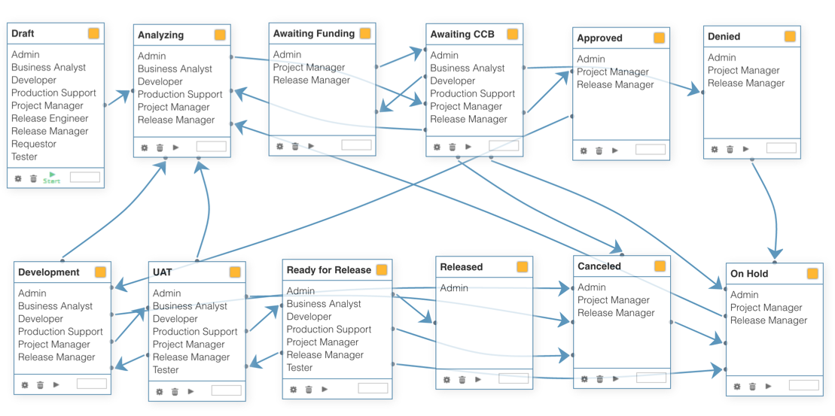
Defect Resolution, Enhancement, New Platform Capability, Platform Enhancement and Regional Enhancement

Slide 3
PLUTORA TECR Status Workflows by Type April 7, 2017 RMO: Internal Use Only

Slide 4
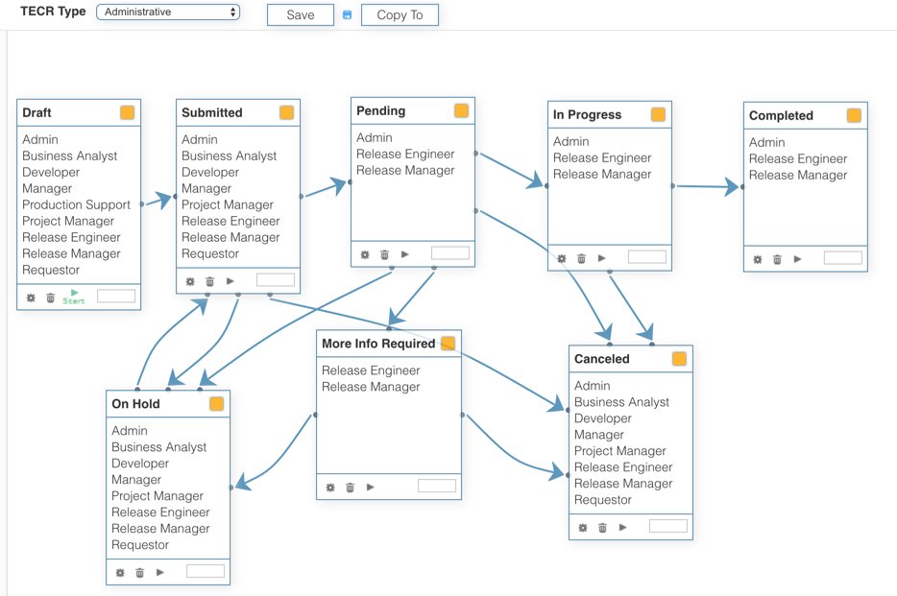
Administrative

Slide 5
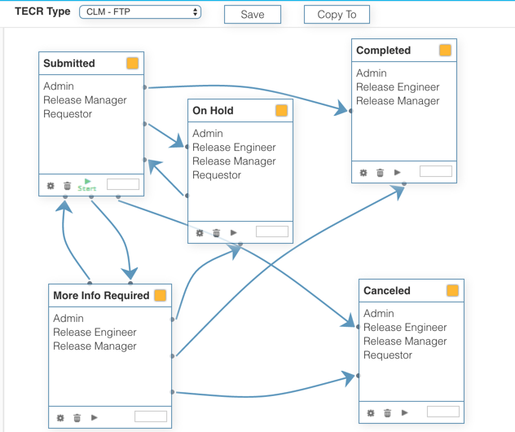
CLM-FTP

Slide 6
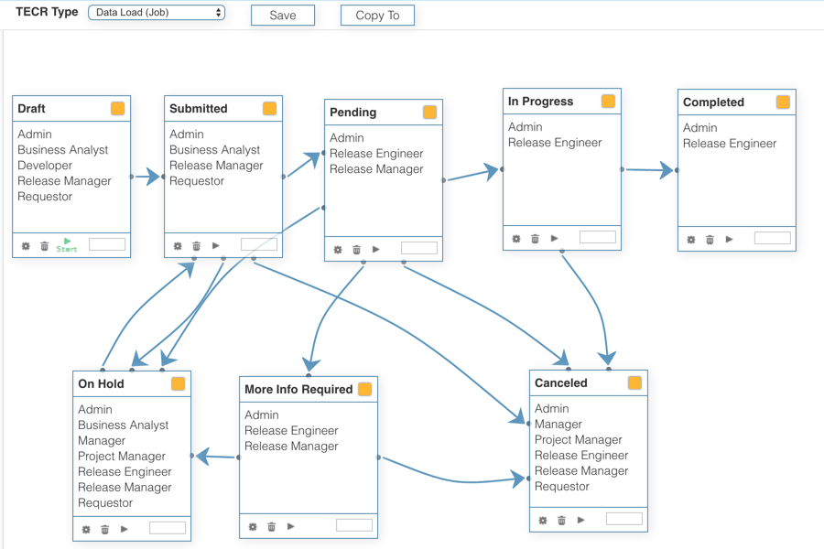
Data Load (Job)

Slide 7
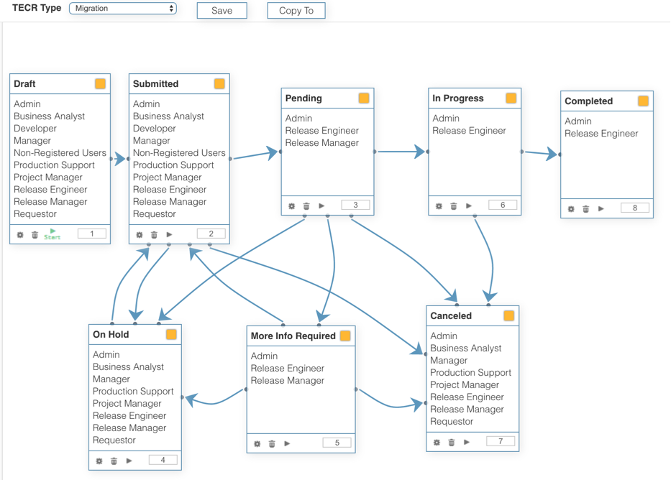
Migration

Slide 8
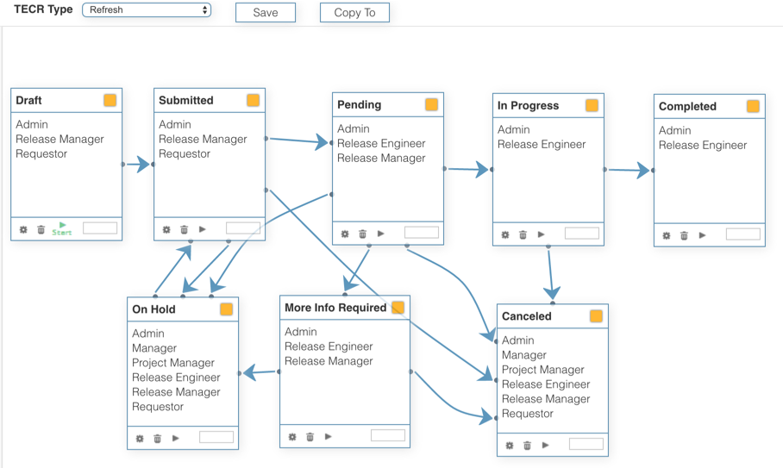
Refresh

Slide 9
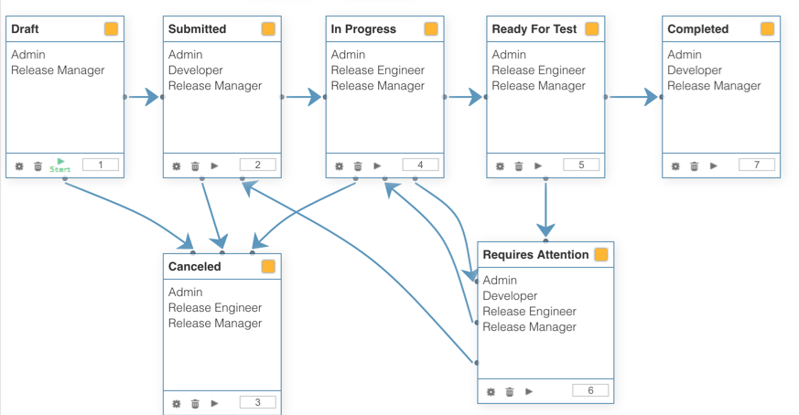
Release Candidate

Slide 10
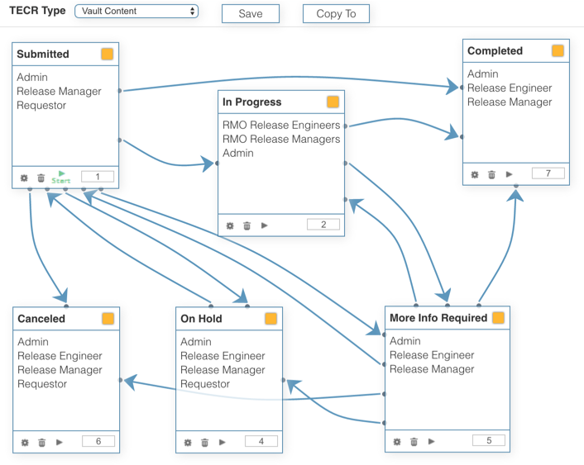
Vault Content

